Slide 1
Lab 1
ITEC618 Labs
Programming Concepts
Dr. Farshid Keivanian

Slide 2
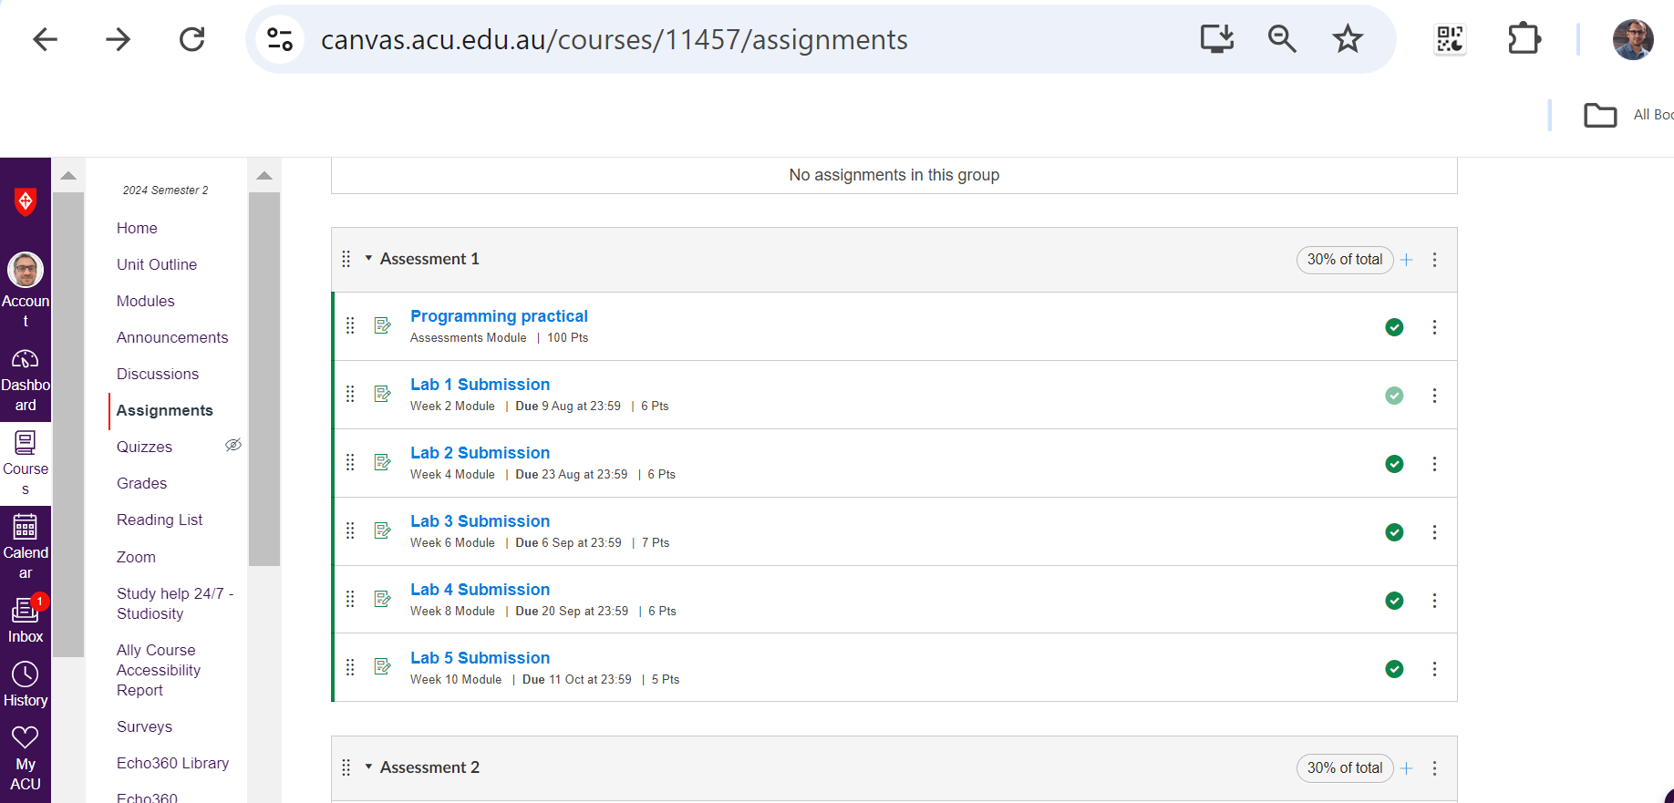

Slide 3
Preparation and Environment Setup
Step 1: Bring Your Laptop
Ensure you bring your laptop, charger, and any other necessary equipment to the lab session.
Step 2: Attend the Lab Session
Attend your allocated lab session on Friday from 11 AM to 1 PM. Attendance is mandatory to receive engagement marks.

Slide 4
Task Completion
Task 2.1: Installing the Java Development Kit (JDK)
Watch Week 1 Videos and Read the Documents
Watch the first and second videos from Week 1 and read the accompanying documents provided under the ‘Class information and resources’ section on CANVAS.
Download and Install JDK
Go to the Oracle JDK website.
Download the latest version of the JDK compatible with your operating system.
Install the JDK on your laptop by following the installation instructions provided.

Slide 5
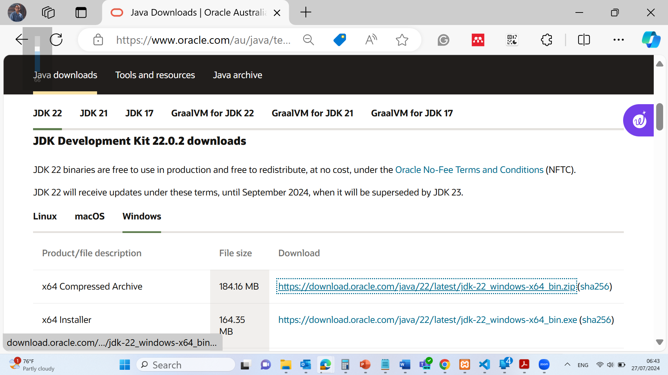
Java Installation:
Download and install the idk package https://www.oracle.com/au/java/technologies/downloads/#jdk22-windows

Slide 6
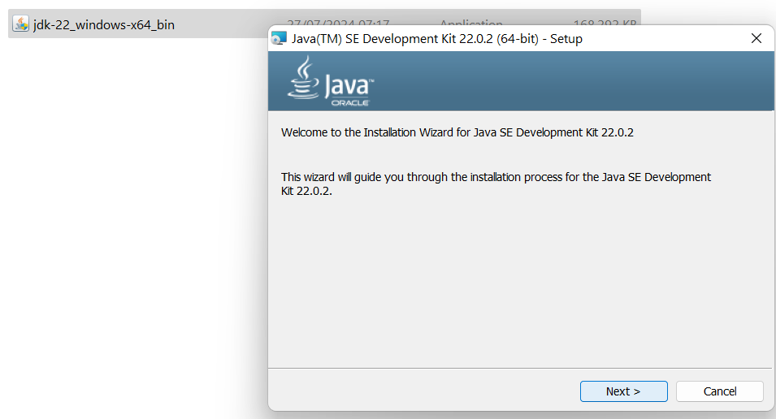
Java Installation:
Download and install the idk package https://www.oracle.com/au/java/technologies/downloads/#jdk22-windows

Slide 7
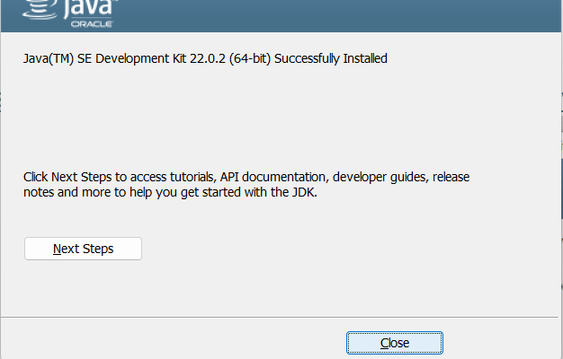
Java Installation:
Download and install the idk package https://www.oracle.com/au/java/technologies/downloads/#jdk22-windows

Slide 8
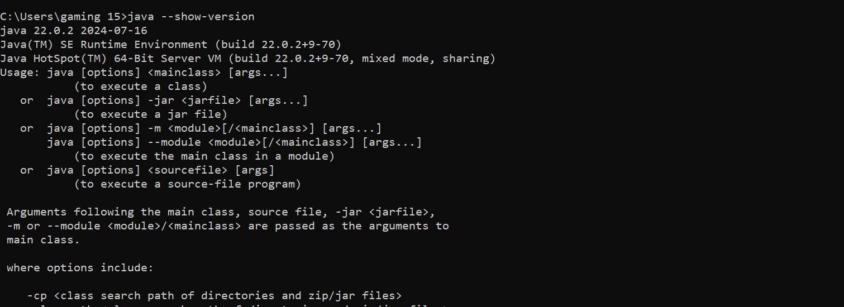
Java Installation:
Command Prompt Windows / Terminal in MAC: java –show-version

Slide 9
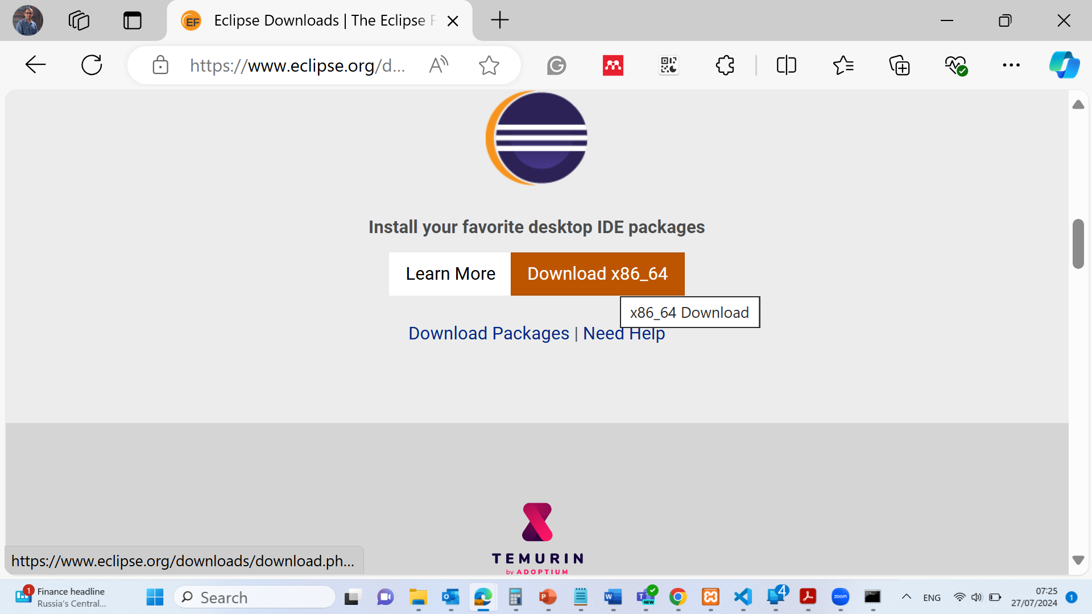
Java Installation:
Download Eclipse Software https://www.eclipse.org/downloads/

Slide 10
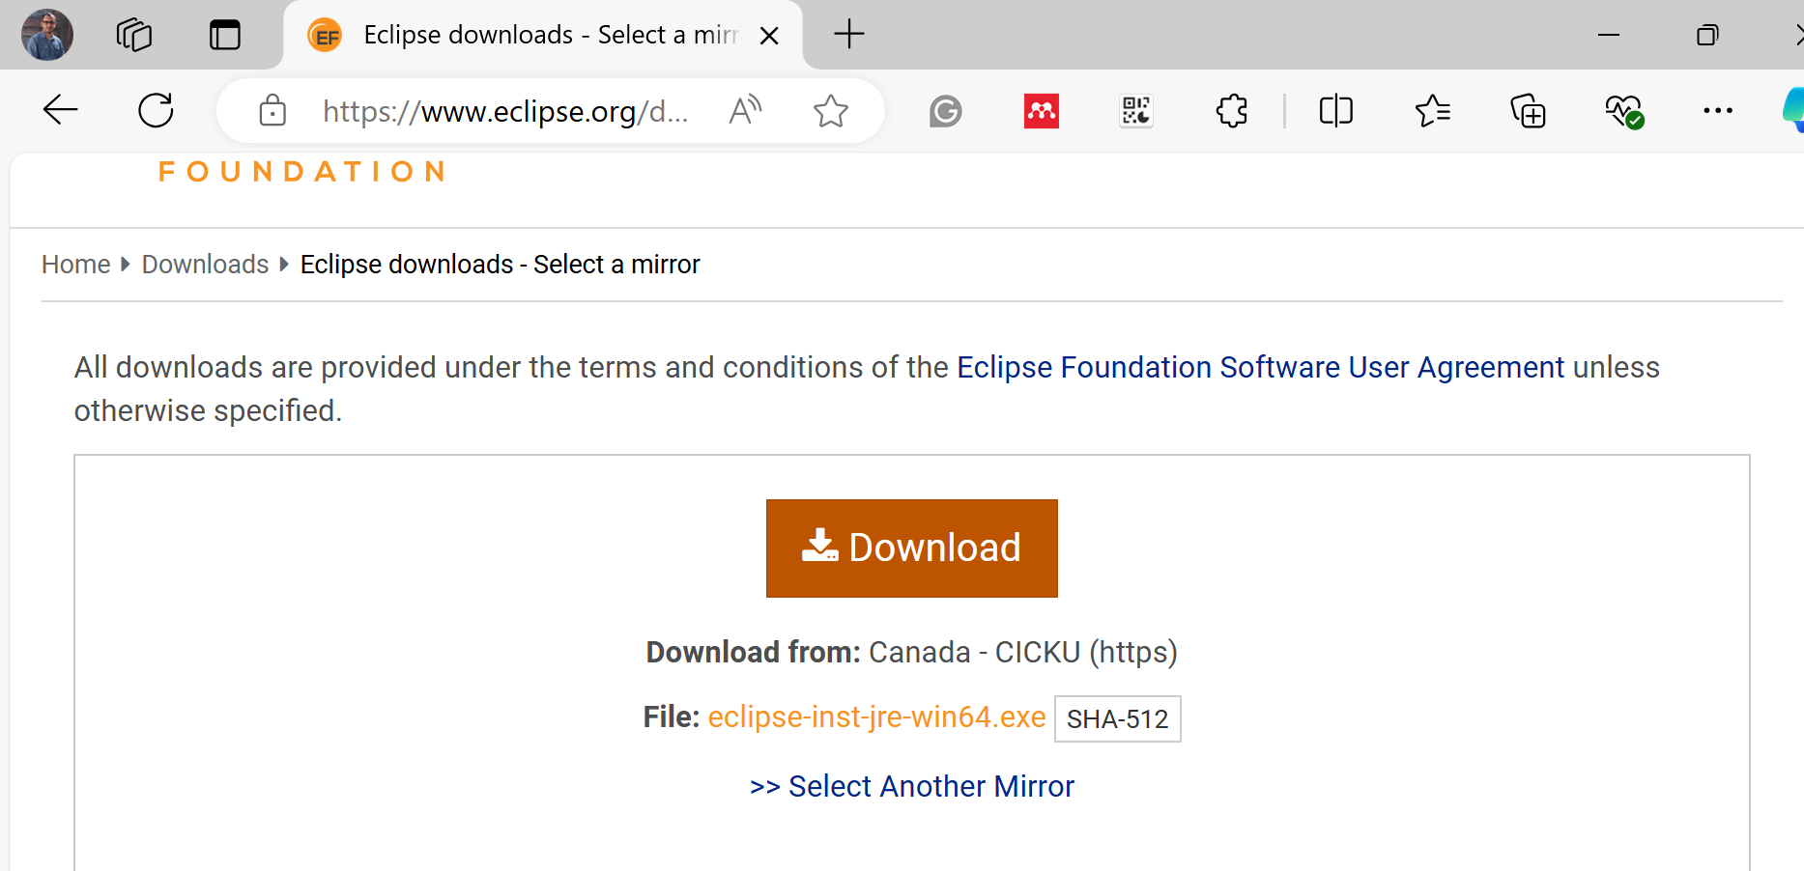
Java Installation:
Download Eclipse Software https://www.eclipse.org/downloads/

Slide 11
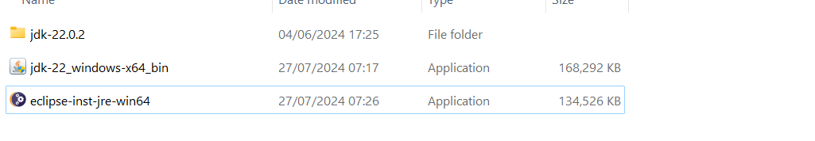
Java Installation:
Install Eclipse Software https://www.eclipse.org/downloads/

Slide 12
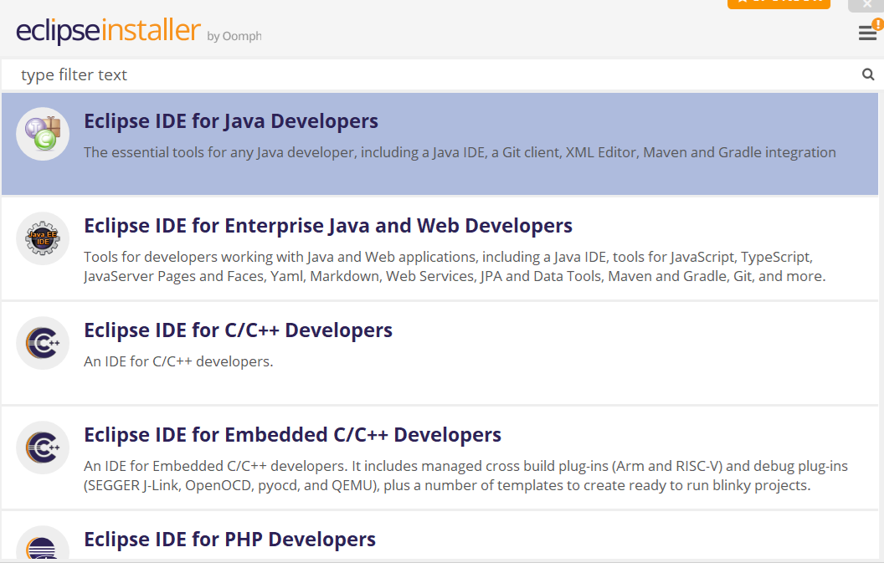
Java Installation:
Install Eclipse Software https://www.eclipse.org/downloads/

Slide 13
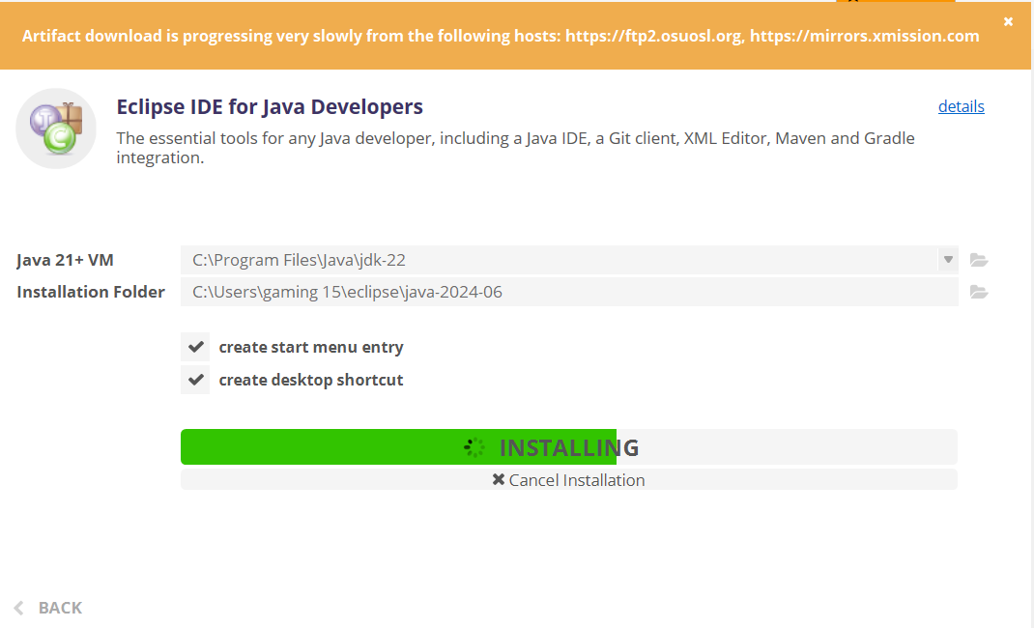
Java Installation:
Install Eclipse Software https://www.eclipse.org/downloads/

Slide 14
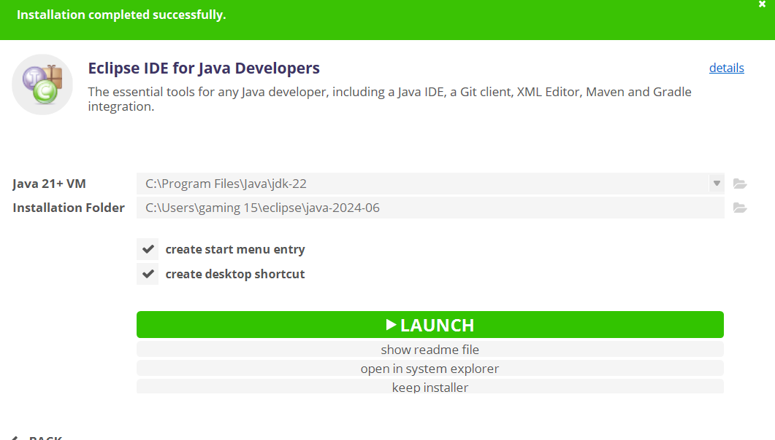
Java Installation:
Install Eclipse Software https://www.eclipse.org/downloads/

Slide 15
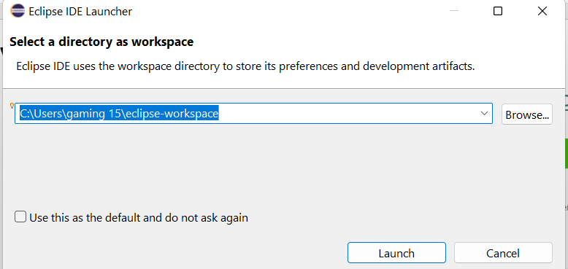
Java Installation:
Install Eclipse Software https://www.eclipse.org/downloads/

Slide 16
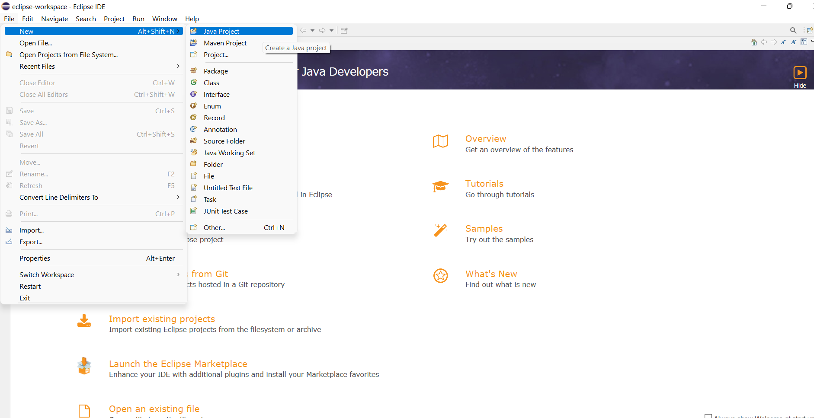
Java Installation:
Install Eclipse Software https://www.eclipse.org/downloads/

Slide 17
Task Completion
3. Verify JDK Installation
Open Command Prompt (cmd) on Windows or Terminal on Mac.
Type javac -version and java -version and press Enter.
Ensure the correct version information is displayed, indicating that JDK is installed correctly.
4. Show Your Tutor
During the lab, show your tutor the successful execution of the javac and java commands.

Slide 18
Task Completion
Task 2.2: Installing Eclipse IDE and Writing Your First Java Program
Watch the Third Week 1 Video and Read the Document
Watch the third video from Week 1 and read the third document under the ‘Class information and resources’ section on CANVAS.
Download and Install Eclipse IDE
Go to the Eclipse website.
Download the latest version of Eclipse IDE for Java Developers.
Install Eclipse IDE on your laptop by following the installation instructions.

Slide 19
Task Completion
3. Create a New Java Project in Eclipse
Open Eclipse and create a new Java project.
Name the project as you wish.
4. Write the Java Program
Inside the new project, create a Java class named WelcomeToACU.java.
Write the following code in your WelcomeToACU.java file

Slide 20
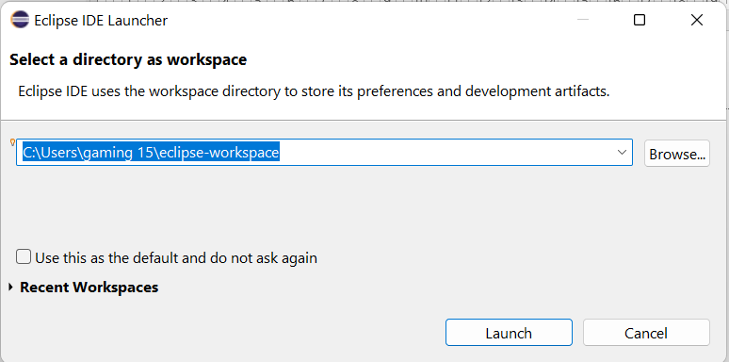
Task Completion
Simple Java Program: Repeated Welcome Message

Slide 21
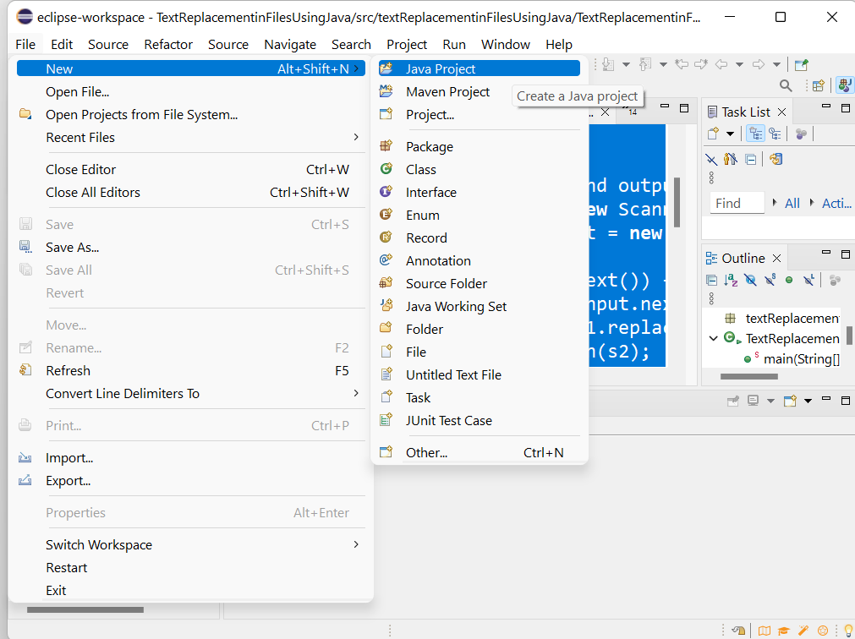
Task Completion
Create a New Java Project

Slide 22
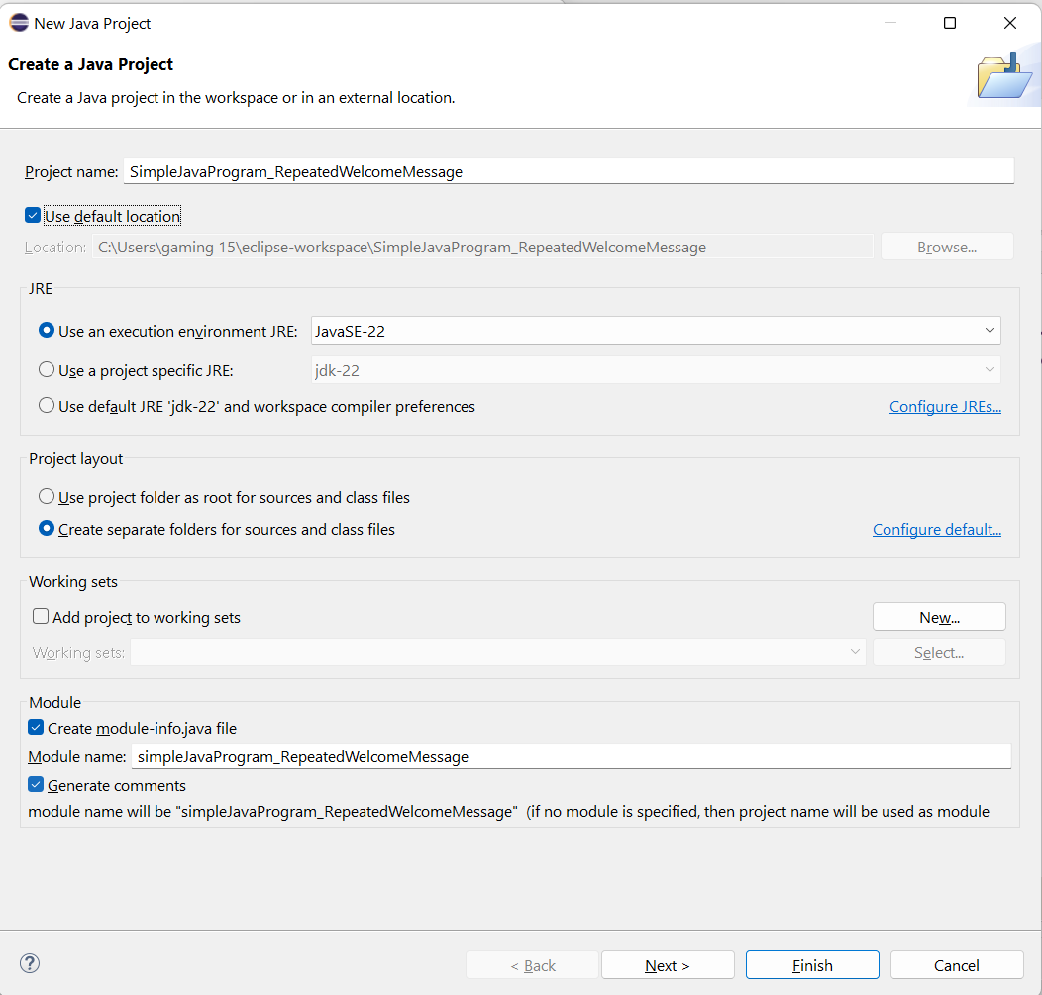
Task Completion
Project Name: SimpleJavaProgram_RepeatedWelcomeMessage

Slide 23
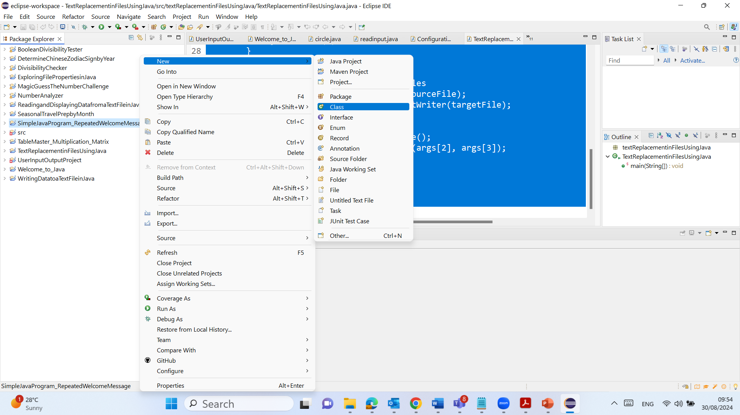
Task Completion
New Java Class (Right Click on the Project >> New >> Class)

Slide 24
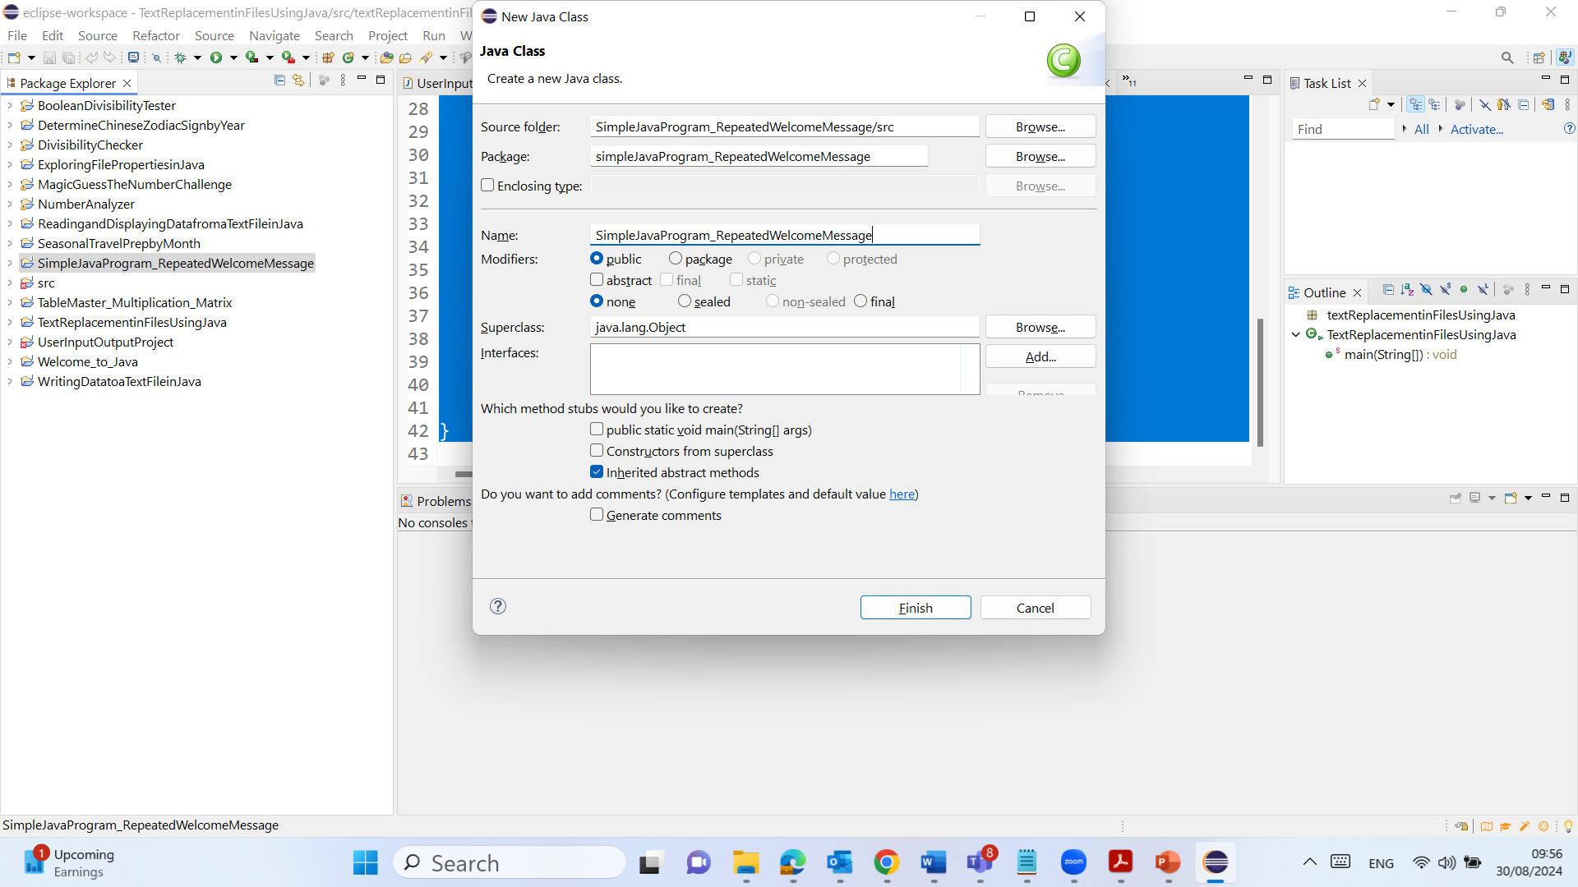
Task Completion
Package Name (starting with a lower-case letter)
Type Name (starting with aan upper-case letter)

Slide 25
Task Completion
Package Name (starting with a lower-case letter)
Type Name (starting with aan upper-case letter)

Slide 26
Task Completion (Please Modify and Explain The Code)
package simpleJavaProgram_RepeatedWelcomeMessage;
public class SimpleJavaProgram_RepeatedWelcomeMessage {
public static void main(String[] args) {
for (int i = 0; i < 5; i++) {
System.out.println("Welcome to ACU!");
}
}
}

Slide 27
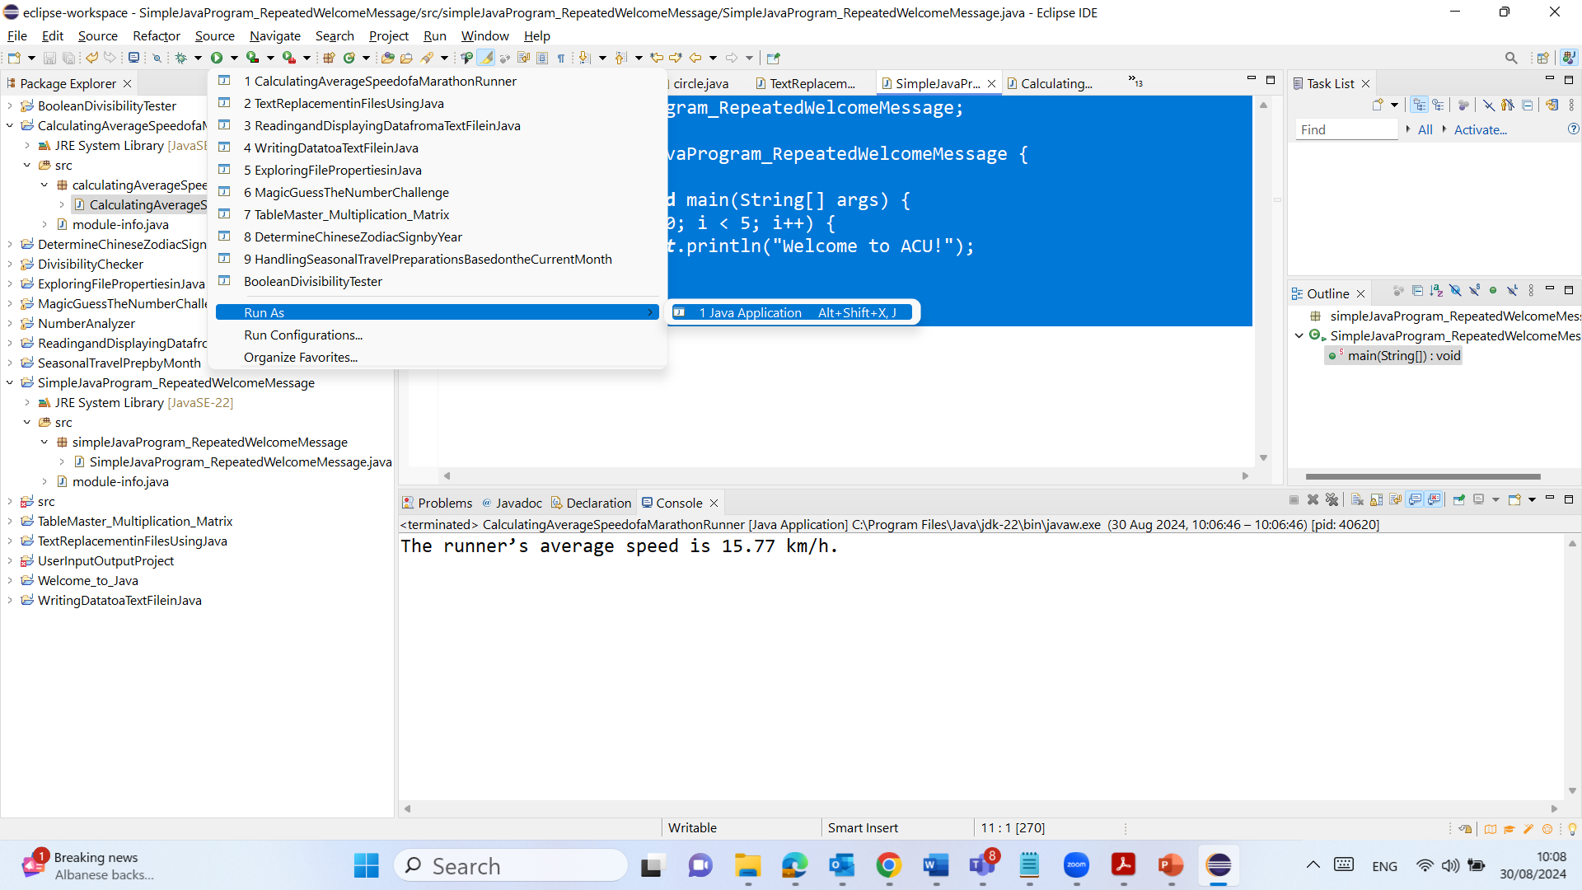
Task Completion (Please Modify and Explain The Code)

Slide 28
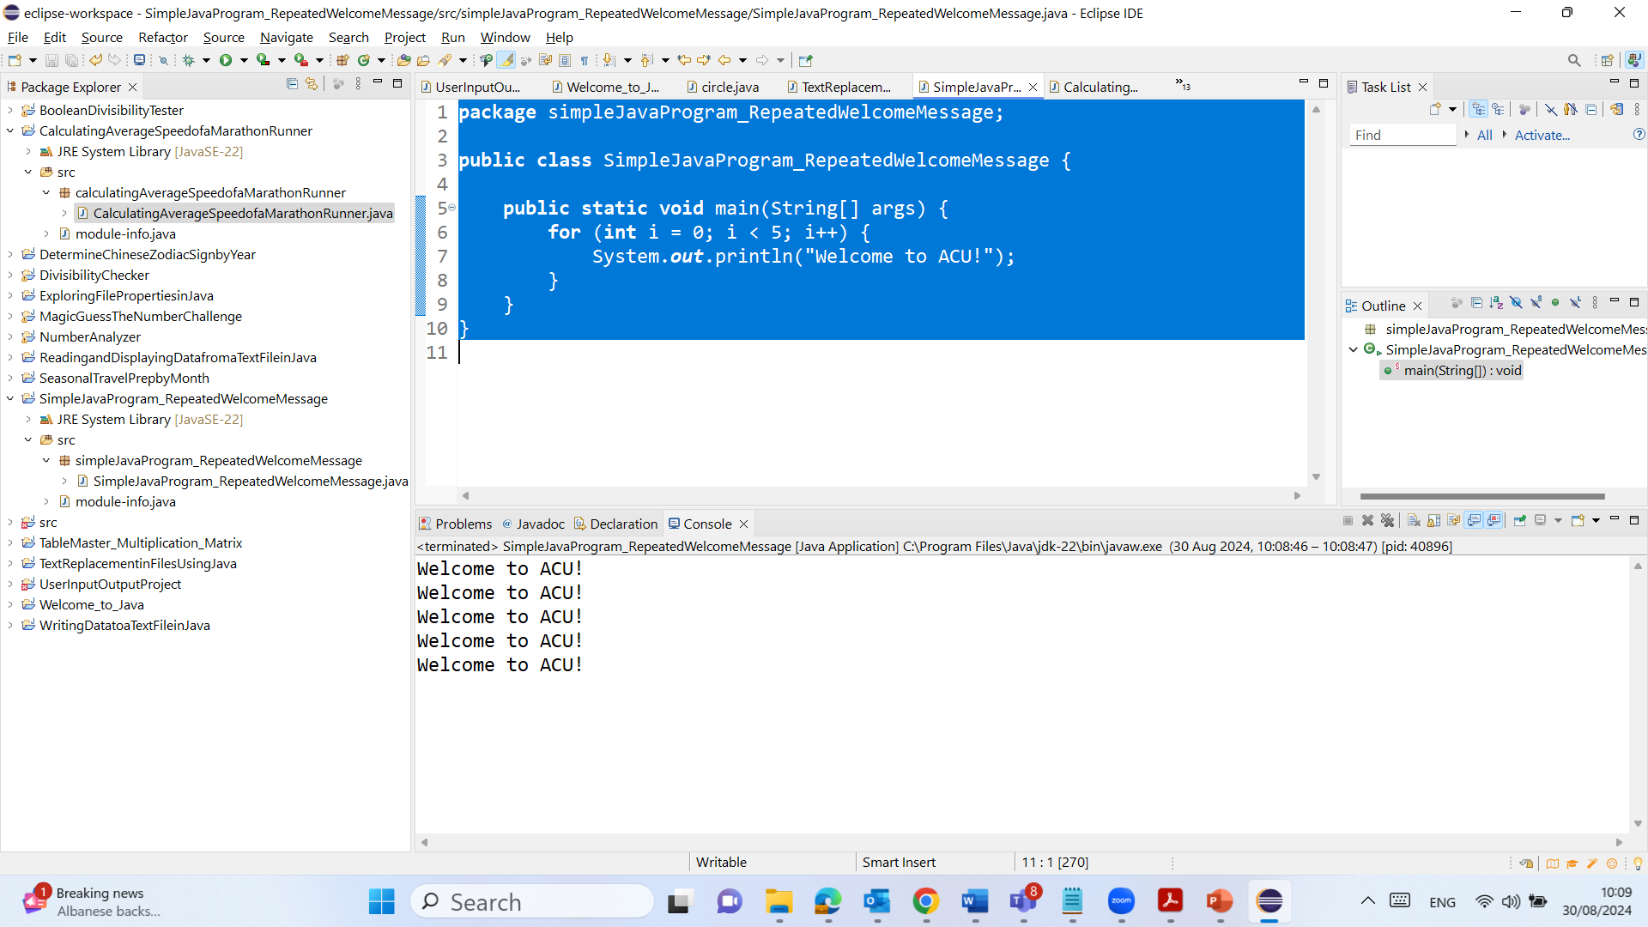
Task Completion (Please Modify and Explain The Code)

Slide 29
Task Completion (Please Modify and Explain The Code)
5. Run the Program
Compile and run the program in Eclipse.
Ensure that "Welcome to ACU!" is displayed five times in the console.
6. Show Your Tutor
During the lab, demonstrate the running program to your tutor.
C:\Users\...\eclipse-workspace\SimpleJavaProgram_RepeatedWelcomeMessage\src\simpleJavaProgram_RepeatedWelcomeMessage

Slide 30
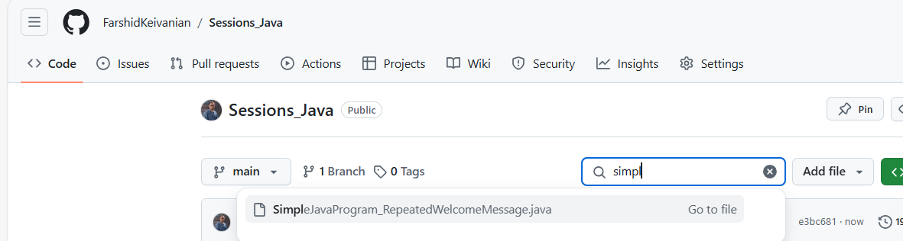
Task Completion (Please Modify and Explain The Code)

Slide 31
Task Completion (Please Modify and Explain The Code)
Task 2.3: Analyzing Marathon Runners
Write a Java Program to Calculate Average Speed
Create a new Java class in Eclipse, for example, MarathonRunner.java.
Write the code to calculate the runner’s average speed:

Slide 32
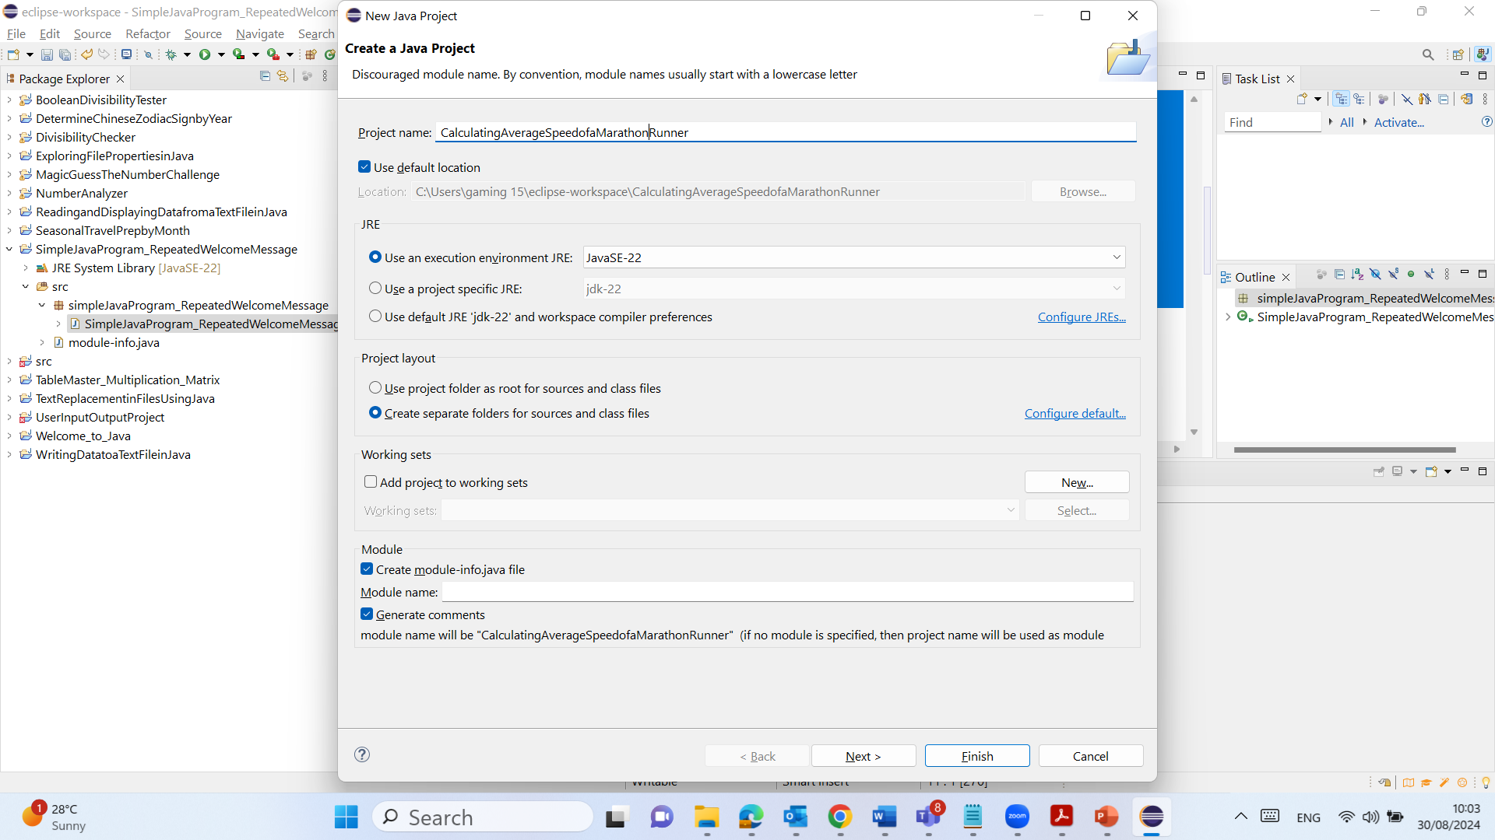
Task Completion (Please Modify and Explain The Code)
New Java Project

Slide 33
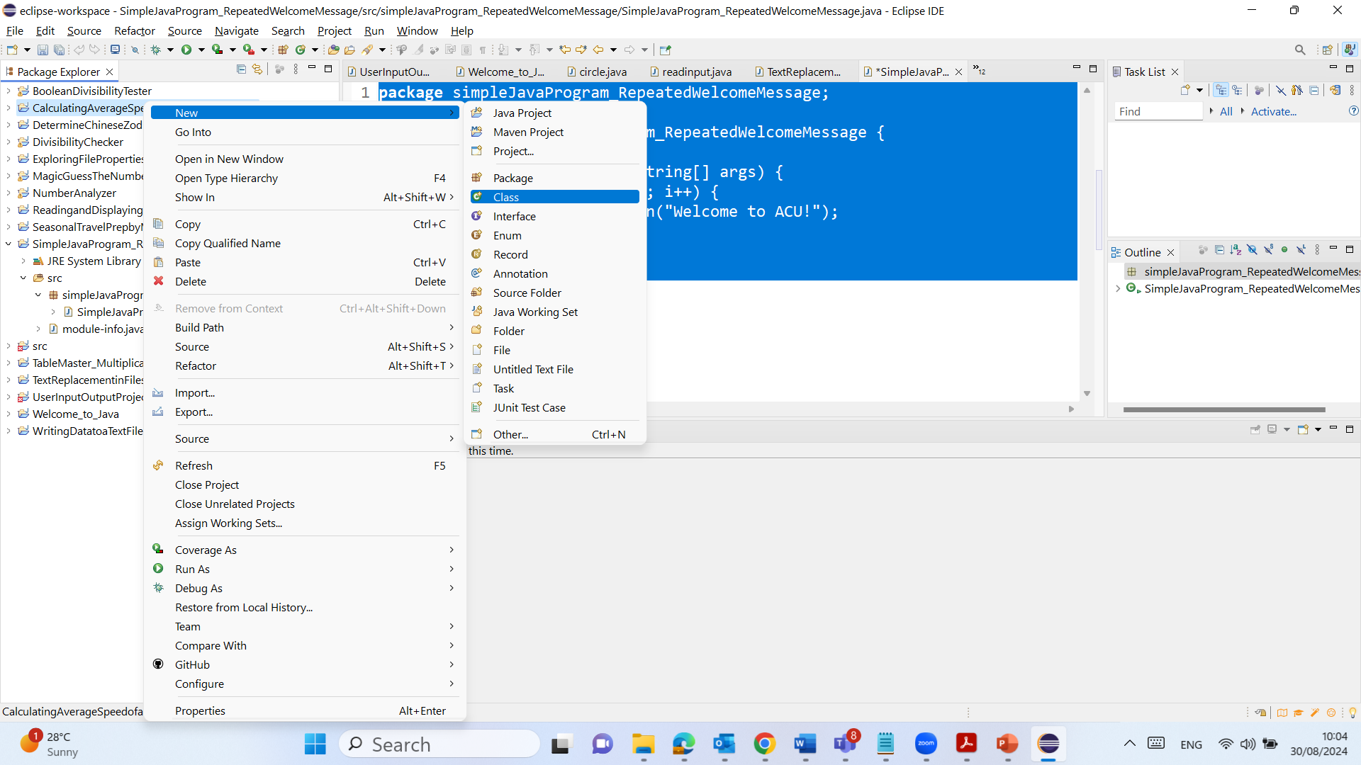
Task Completion (Please Modify and Explain The Code)
New Java Class

Slide 34
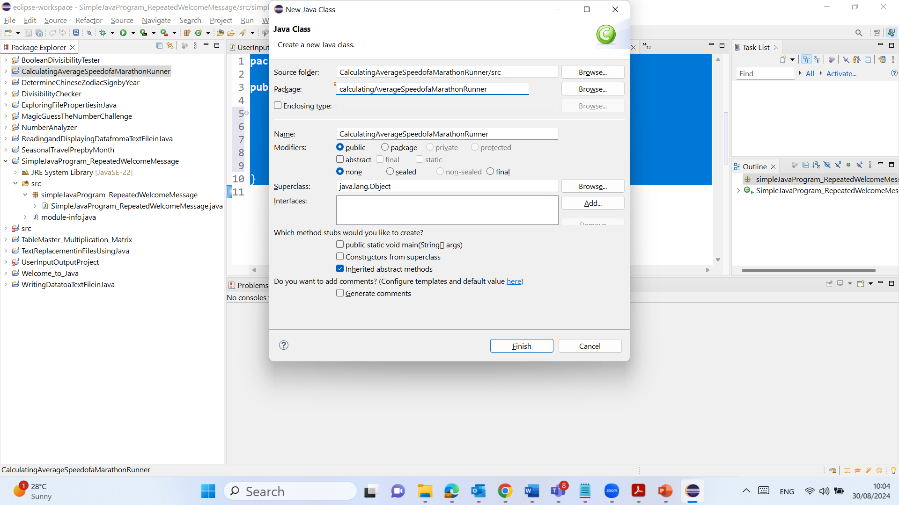
Task Completion (Please Modify and Explain The Code)
New Package

Slide 35
Task Completion (Please Modify and Explain The Code)
package calculatingAverageSpeedofaMarathonRunner;
public class CalculatingAverageSpeedofaMarathonRunner {
public static void main(String[] args) {
double distance = 42.195; // in kilometers
int hours = 2;
int minutes = 40;
int seconds = 35;
// Convert time to hours
double timeInHours = hours + (minutes / 60.0) + (seconds / 3600.0);
// Calculate average speed
double averageSpeed = distance / timeInHours;
// Display the result
System.out.printf("The runner’s average speed is %.2f km/h.%n", averageSpeed);
}
}

Slide 36
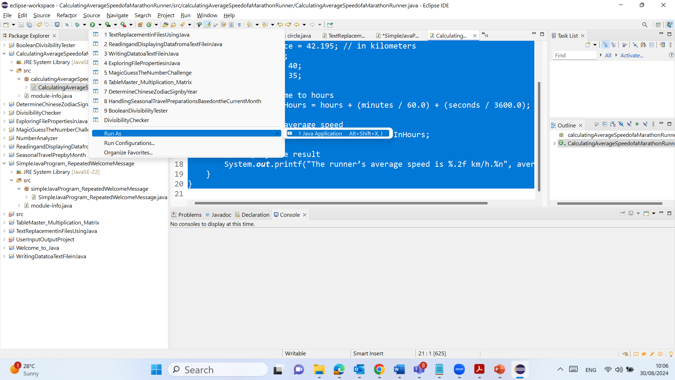
Task Completion (Please Modify and Explain The Code)

Slide 37
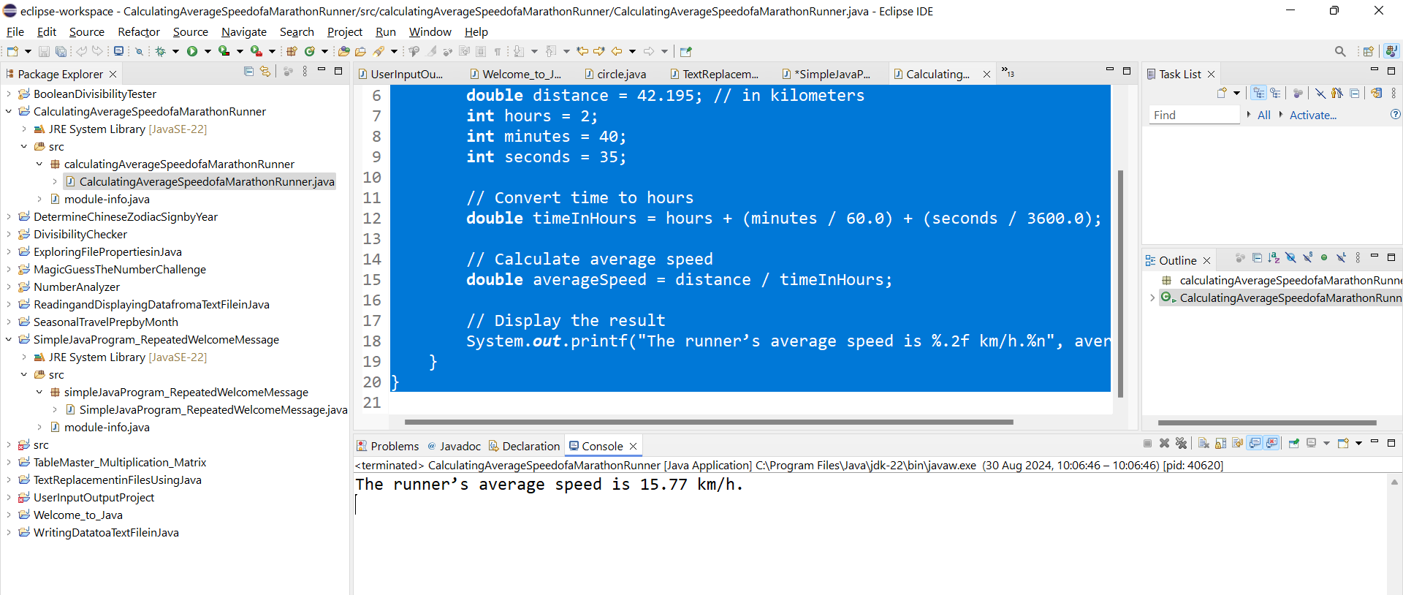
Task Completion (Please Modify and Explain The Code)
C:\Users\...\eclipse-workspace\CalculatingAverageSpeedofaMarathonRunner\

Slide 38
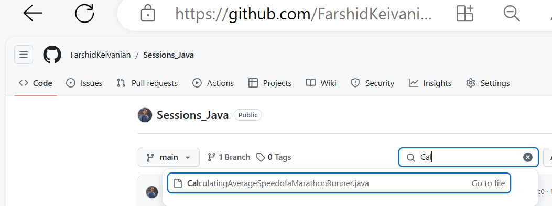
Task Completion (Please Modify and Explain The Code)

Slide 39
Task Completion (Please Modify and Explain The Code)
2. Run the Program
Compile and run the program in Eclipse.
Ensure the program correctly calculates and displays the runner’s average speed.
3. Show Your Tutor
Demonstrate the program’s output to your tutor during the lab.

Slide 40
Task Completion (Please Modify and Explain The Code)
3. After-Lab Submission
Prepare Your Submission Document
Copy the source code for each task from Eclipse and paste it into a Word or PDF document.
Include screenshots of the program outputs:
For Task 2.1: Screenshot of the successful execution of javac and java commands.
For Task 2.2: Screenshot of the "Welcome to ACU!" program output in Eclipse.
For Task 2.3: Screenshot of the marathon runner’s average speed program output.
Ensure Proper Code Formatting
Ensure your code is well-formatted with appropriate indentation, naming conventions, and comments.
Submit Your Document
Upload your document through the ‘Assessment 1 - Lab 1 Submission’ Turnitin link on CANVAS by due date (check the Canvas)

Slide 41
Task Completion (Please Modify and Explain The Code)
4. Academic Integrity
Ensure that your work is original and follows ACU’s academic integrity guidelines. Do not share your code with other students, and avoid copying solutions from the internet.
By following these steps, you will successfully complete the lab and fulfill the requirements for both engagement and task completion marks.

